Slide 1
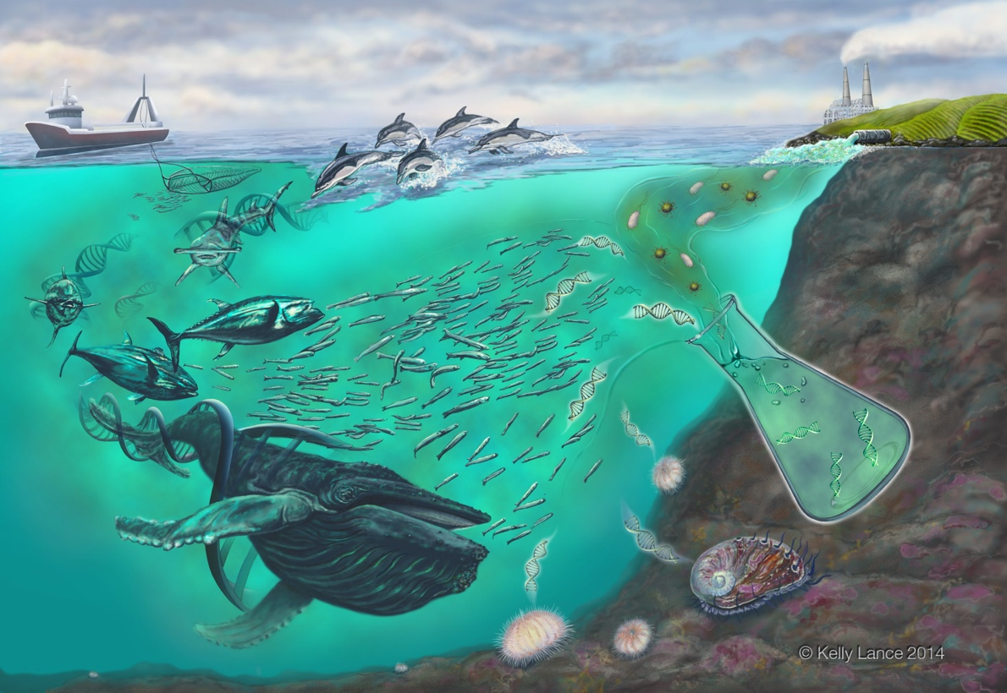

Environmental DNA in the Ocean
Ryan Kelly, JD, PhD

Slide 2
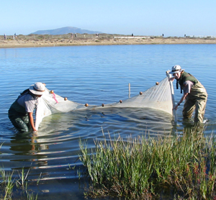
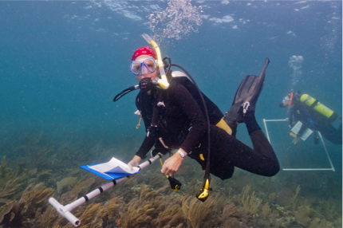
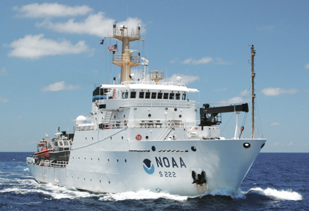
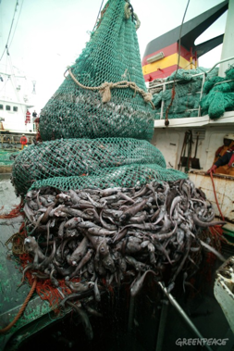
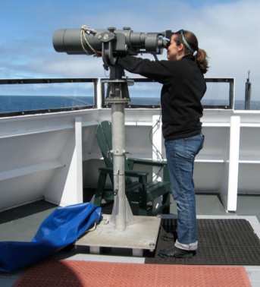
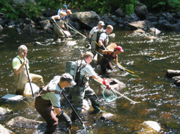
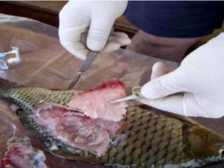
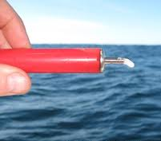
Conventional Biological Sampling
Notes:
-Conventional methods to monitor aquatic ecosystems are time intensive, costly and can be invasive.
-These include different forms of in situ observation, including net fishing, trawls, hook and line, dive surveys, sightings, ship-time, assaying and even destructive techniques
-We are exploring new approaches by which to observe the ocean in a way that meets these challenges.

Slide 3

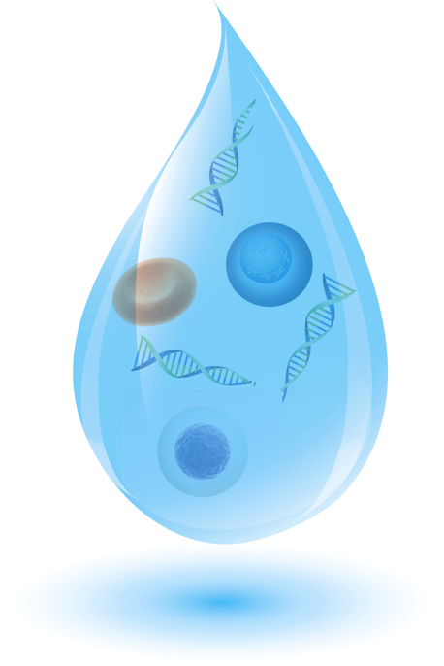
The Ocean is a Soup of Information
Tissue
Skin and scales
Free DNA /
RNA / Proteins
Metabolic waste
Notes:
-Environmental DNA, or eDNA, is sourced from metabolic waste, shed skin cells, or in some cases free DNA that has been cast off by an organism into its surrounding environment. -
-Sampling this environmental DNA (eDNA) is a potentially powerful means of assessing whole biological communities.

Slide 4
Relevant ‘omics
DNA → RNA → Protein
Genomics
Transcriptomics
Proteomics
What genes are present?
What genes are expressed?
What proteins are produced?

Slide 5
DNA
Genomics
Diagnostic
Which species are present/absent?
Which species characterize “good” vs. “bad” habitats?
Where/when does a species congregate?
Functional
Are genetic pathways in place to fix carbon?
Are complementary / competitive functions present?
What genes are present?

Slide 6

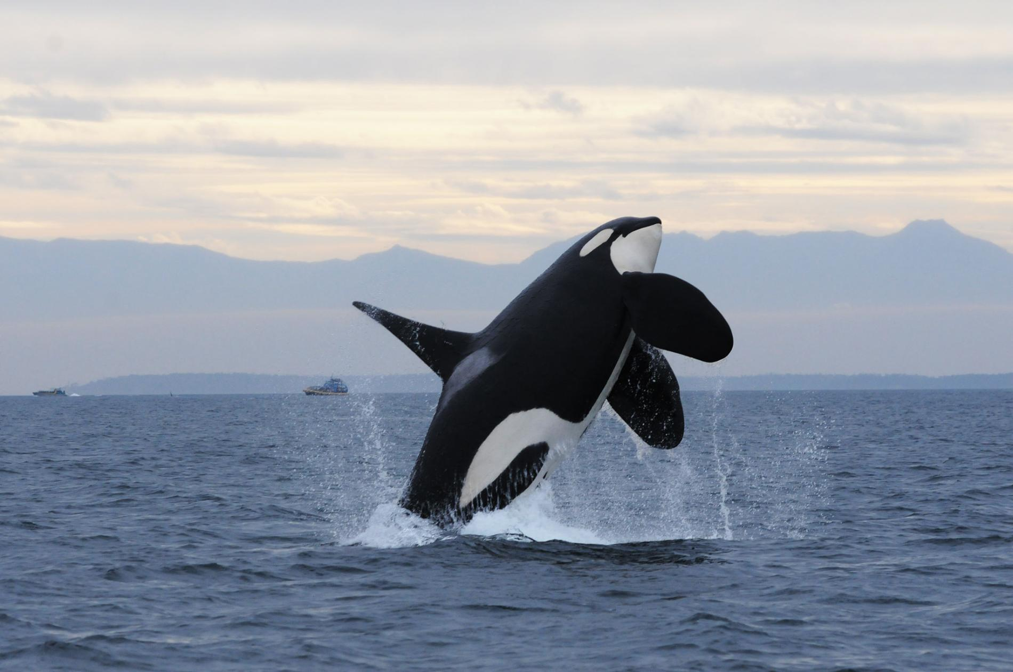
DNA as a Sampling Tool
From microbes…
To killer whales
Notes:
Waples and others have focused on using DNA for conservation/management purposes: identifying individuals, population parameters, etc.

Slide 7
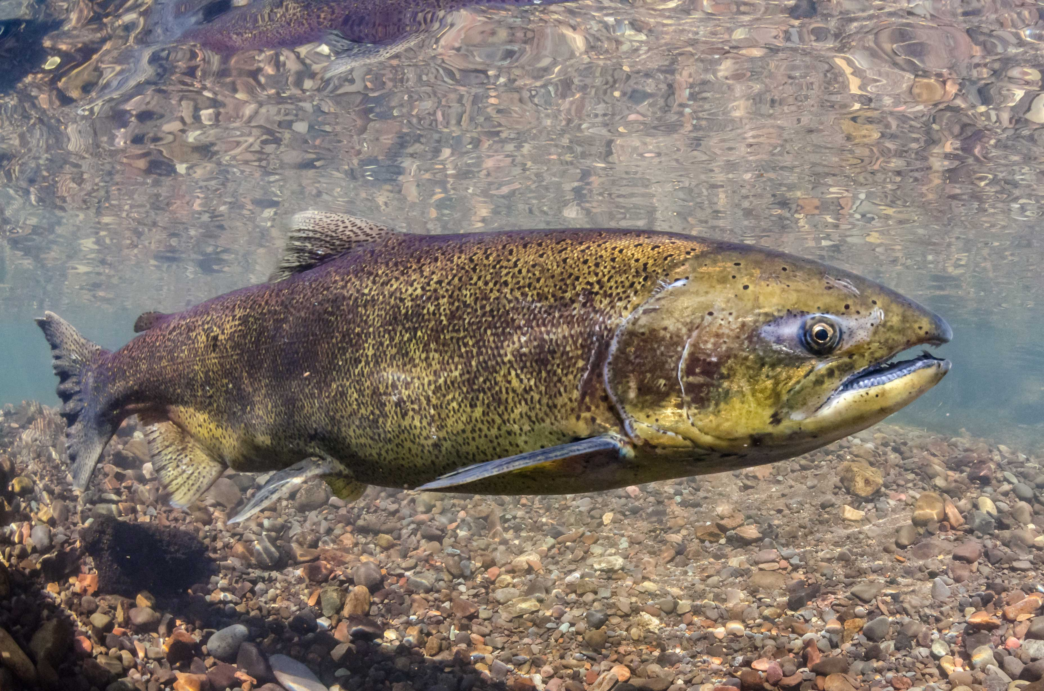
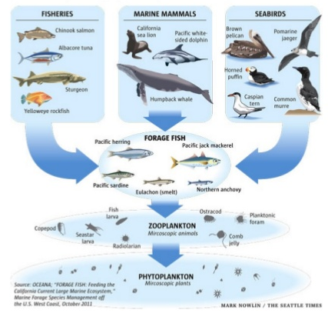
Two eDNA techniques
Quantitative PCR (qPCR)
One species at a time
Quantitative
Sequencing
Hundreds/thousands of species at a time
Less quantitative

Slide 8
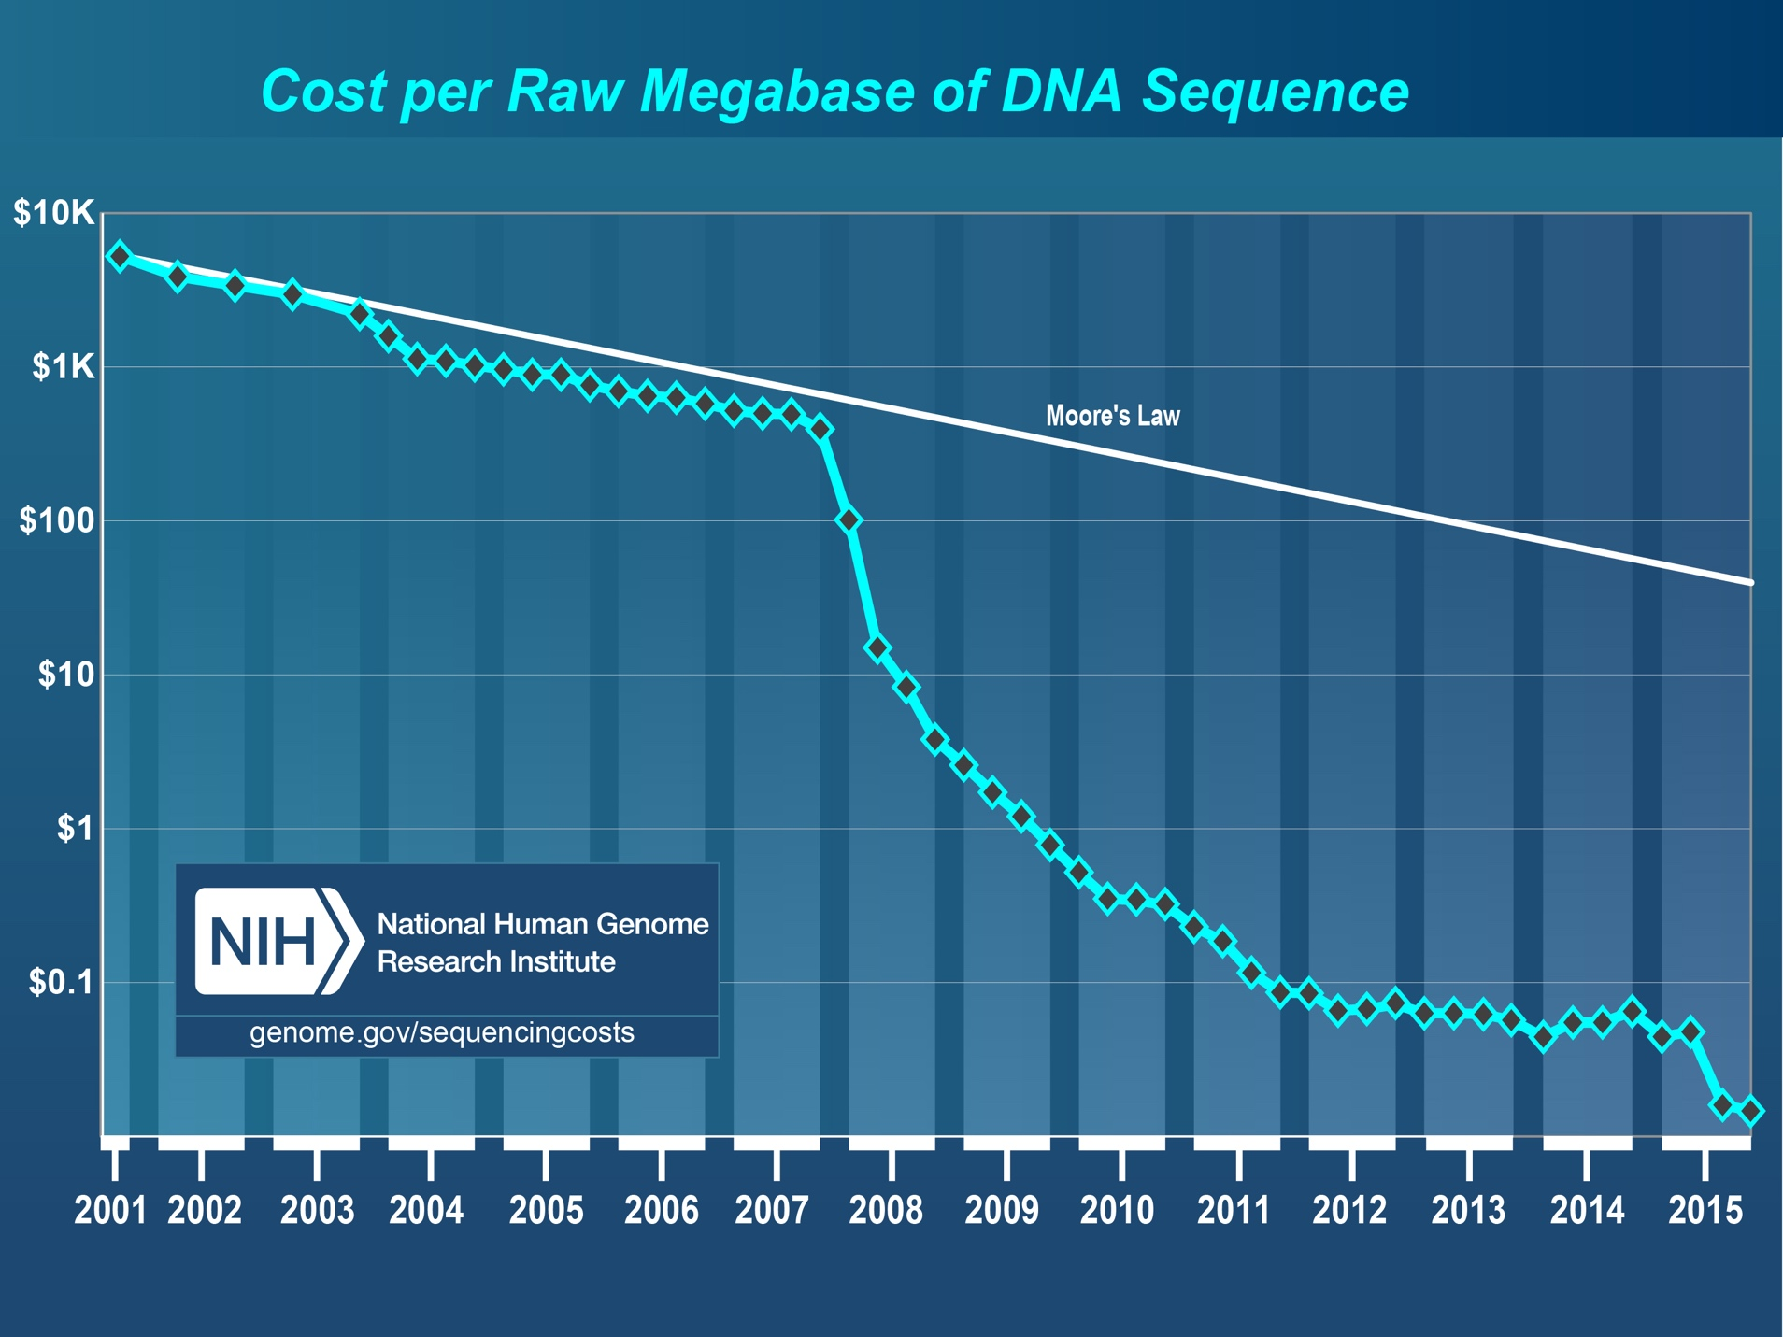
Sequencing costs

Slide 9
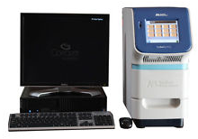
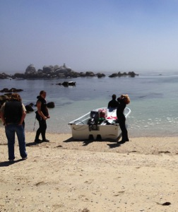
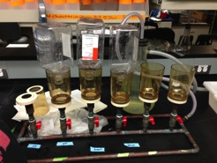
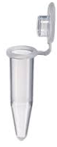
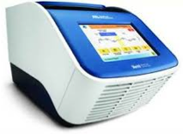
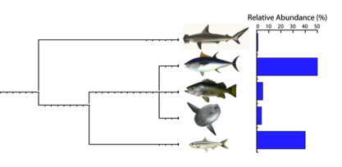
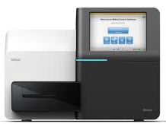
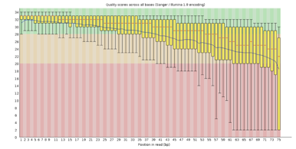
eDNA workflow
qPCR
DNA extraction
PCR
Water sampling
Water filtration
Taxonomic annotation
Bioinformatics
Sequencing
Notes:
-So what does an eDNA study look like?
-It starts in the field with water sampling (and any supplemental validation techniques), we collect 1-liter water samples.
-Samples are then filtered to capture a desired size fraction, followed by extracting the DNA from the filters.
-The target gene of interest is then amplified with PCR to generate millions of copies of that one gene, and then these amplicons as we call them are prepped for sequencing and then sequenced so that we can determine the taxonomic identity of the amplicon.

Slide 10
Targeting organisms in mixed samples
A tweezer / photocopier
Bacteria
PCR amplification using taxon-specific primers
Algae
Vertebrates
Vertebrates
Invertebrates
Community DNA
Vertebrate DNA
Notes:
To illustrate this, the tube on the left is the DNA extract from a seawater sample.
--In this extract are many different groups, including bacteria, algae, vertebrates, and invertebrates, with a strong bias towards bacteria and algae as these dominate a seawater
sample.
--If we’re interested in only pulling out the very small fraction of vertebrate DNA in the sample, we need to design vertebrate specific primers and barcodes so that after the PCR step we are left with the tube on the right.

Slide 11
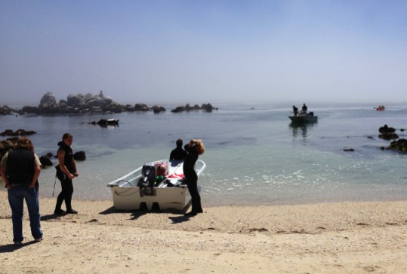
What Benefit?
qPCR
Vastly improved detection of rare targets
Rapid quantification
Amplicon sequencing
Thousands of species at once
Alleviates depth/breadth tradeoff
Notes:
It is incredible that I can get starfish, birds of prey, surfperch, copepods, and porpoise out of the same glass of water. But we already knew those things were living in Puget Sound. Does eDNA provide a benefit that we can’t get elsewhere? It is uniquely valuable, and does it speak to questions that are already being asked?
Coming at the policy question from a legal background: what do existing laws/regs demand? If we can speak to those demands, uptake is quick.
Try to avoid classic science-policy interaction, in which scientists try and hand policymakers something they didn’t ask for.
Provides answers not otherwise easily attainable. So, yes: likely to be valuable.
And remarkably, a lot of the high-profile eukaryotic eDNA work done to date had explicit policy aims. Many examples of collaborating with the target audiences (agencies) to develop relevant techniques and ensure relevance.

Slide 12
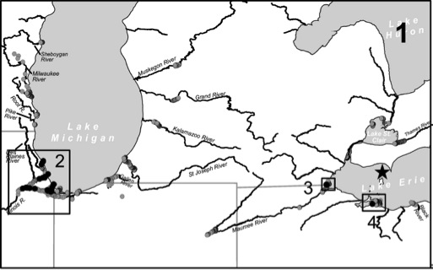
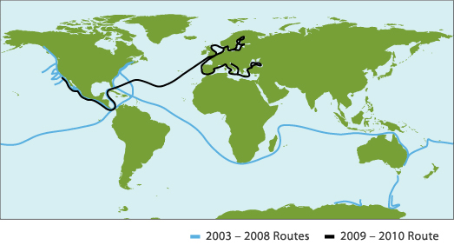
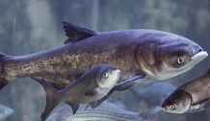
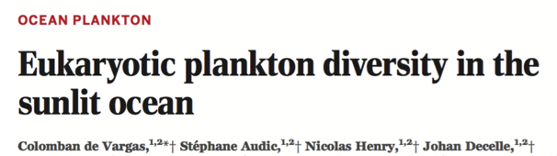
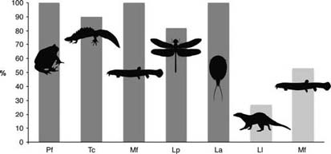
Some examples
qPCR
Sequencing
Invasive species
Plankton and Microbial diversity
Rusch et al. 2007 PLoS Biol 5:e77
Jerde et al. 2013, Can J Fish Aquatic Sci 70:522-526
Endangered species
Community Surveys
Port et al. 2016
Thomsen et al. 2012, Mol Ecol 21:2565-2573
Notes:
-eDNA has already been shown to be a effective tool for a number of applications.
-eDNA (in the form of complete bacterial cells) has been used for quite some time now by environmental microbiologists to survey microbial diversity and bacterial structure in the oceans (e.g. Global Ocean Sampling Expedition).
--Microbial eDNA approaches are well-vetted.
-On the other hand, only recently has eDNA been applied to multicellular life and higher organisms such as fish and mammals.
-Early work has used eDNA to track invasive species in freshwater systems, including the Asian carp in the Great Lakes
-eDNA has also been used to determine the distribution of endangered and rare species in freshwater systems.
-One of the applications we’re interested in at COS is the use of eDNA to monitor biodiversity levels and species distribution in MPAs.
Fig. 2 Environmental DNA detection rates by qPCR in natural freshwater ponds with 100% occurrence of the species confirmed in the field (dark grey) or larger freshwater systems with known occurrence in the area (light grey). Detection rates are given in percentage positive localities out of the total number of localities surveyed for each species. Data covers amphibians: Pf (Pelobates fuscus, n = 9) and Tc (Triturus cristatus, n = 11); fish: Mf (Misgurnus fossilis, n = 11 ponds and n = 15 streams—light grey); insects: Lp (Leucorrhinia pectoralis, n = 11); crustaceans: La (Lepidurus apus, n = 10) and mammals: Ll (Lutra lutra, n = 15 streams and lakes).

Slide 13
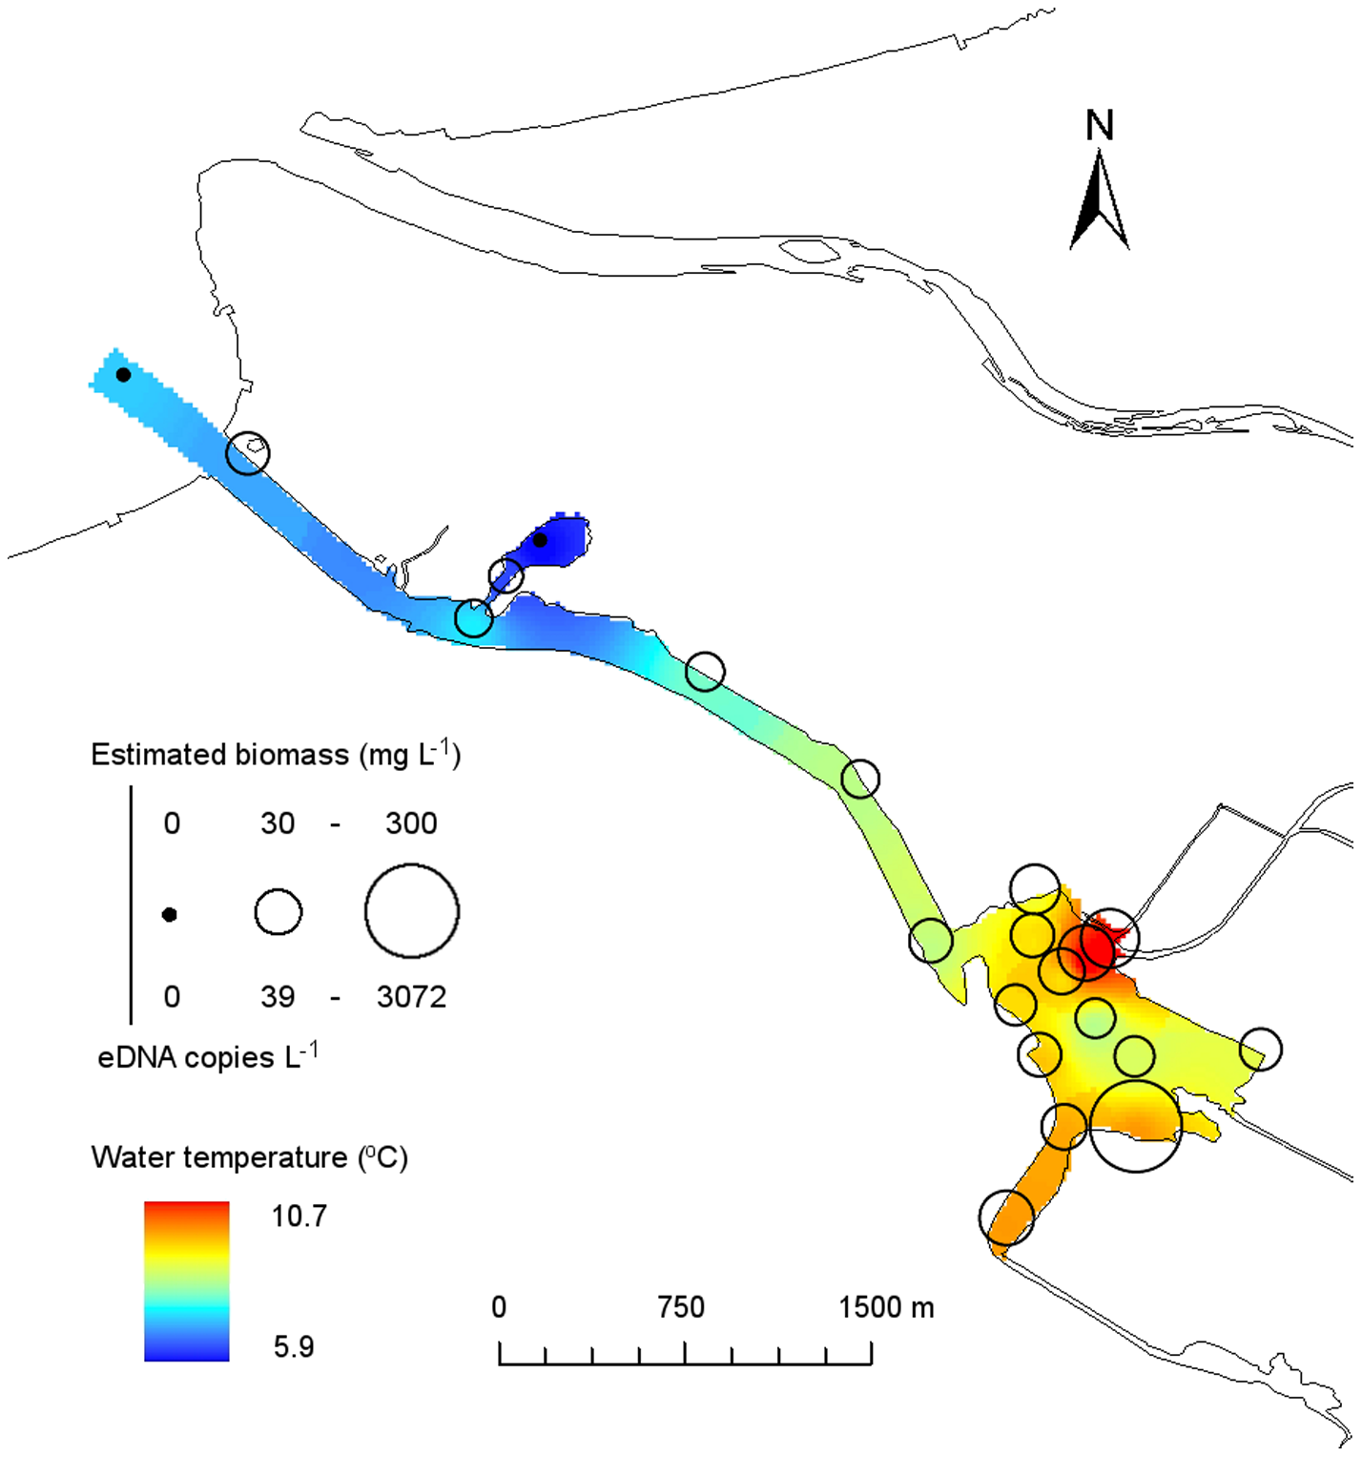
Frontiers and Challenges
- Quantification
1 fish ≠ 1 eDNA read
- Amplification-free techniques
(e.g., Xin Zhou, China Agricultural University)
- Generalizing results spatial/temporal resolution
Takahara et al. 2012
Notes:
-eDNA has already been shown to be a effective tool for a number of applications.
-eDNA (in the form of complete bacterial cells) has been used for quite some time now by environmental microbiologists to survey microbial diversity and bacterial structure in the oceans (e.g. Global Ocean Sampling Expedition).
--Microbial eDNA approaches are well-vetted.
-On the other hand, only recently has eDNA been applied to multicellular life and higher organisms such as fish and mammals.
-Early work has used eDNA to track invasive species in freshwater systems, including the Asian carp in the Great Lakes
-eDNA has also been used to determine the distribution of endangered and rare species in freshwater systems.
-One of the applications we’re interested in at COS is the use of eDNA to monitor biodiversity levels and species distribution in MPAs.
Fig. 2 Environmental DNA detection rates by qPCR in natural freshwater ponds with 100% occurrence of the species confirmed in the field (dark grey) or larger freshwater systems with known occurrence in the area (light grey). Detection rates are given in percentage positive localities out of the total number of localities surveyed for each species. Data covers amphibians: Pf (Pelobates fuscus, n = 9) and Tc (Triturus cristatus, n = 11); fish: Mf (Misgurnus fossilis, n = 11 ponds and n = 15 streams—light grey); insects: Lp (Leucorrhinia pectoralis, n = 11); crustaceans: La (Lepidurus apus, n = 10) and mammals: Ll (Lutra lutra, n = 15 streams and lakes).

Slide 14


And Introducing…
Meng Yao
(Peking University)
Anni Djurhuus
(University of South Florida)

